Slide 1

Career Performance Prediction App
- Greeshmanth Srireddy
Sai Dhanya Kakarala
Praful Chand Potluri

Slide 2
Agenda
INTRODUCTION
OBJECTIVE
DATA
EXPLORATORY DATA ANALYSIS
BUILDING PREDICTIVE MODELS USING ML
DEMO
FUTURE SCOPE

Slide 3
Introduction

Slide 4
Introduction
In today's rapidly evolving job market, professionals across various industries seek to gain insights into their career trajectories. Understanding factors that contribute to career advancement can empower individuals to focus on actionable goals and improve their professional growth outcomes.
Our project aims to provide professionals with insights into their career progression by using data analysis and machine learning. We've developed an easy-to-use web application using R Shiny that predicts career advancement based on factors like experience and skills.
This project is particularly relevant as it addresses the need for personalized career advice tailored to individual profiles, leveraging historical data and advanced analytics.

Slide 5
Objective

Slide 6
Objective
The project aims to bridge the gap between data-driven insights and practical career development strategies, empowering individuals to make informed decisions about their professional growth and trajectory by completing the following objectives.
Utilize Historical Data Analysis : Analyze existing datasets on professional development and career progression to identify key factors that historically influence career advancement.
Develop Predictive Models : Implement machine learning algorithms, particularly Random Forest, to predict the probability of career advancement based on identifiable metrics such as years of experience and skill counts.
Provide Actionable Insights : Generate personalized reports for users that highlight strengths and areas for improvement, aiding them in strategic career planning.
Enhance Career Planning Tools : Integrate the predictive model into a user-friendly application using R's Shiny framework, enabling professionals to evaluate their career advancement opportunities easily.

Slide 7
Data

Slide 8
Data
The dataset used in our project consists of information related to professionals' career trajectories and skill profiles. It includes several key variables that are crucial for predicting career advancement probabilities. Here's a brief overview of the data:Stay calm
Total Years of Experience : This variable represents the cumulative number of years individuals have spent in their respective fields or industries. It serves as a fundamental indicator of professional expertise and tenure.
Skills Count : This variable quantifies the number of skills possessed by individuals, encompassing both technical proficiencies and soft skills relevant to their roles. It provides insights into the breadth and depth of their skill sets.
Career Advancement : The target variable indicates whether individuals have experienced career advancement within their organizations. It is a binary variable, where '1' denotes advancement and '0' signifies no advancement, based on historical records.
Additional Demographic and Professional Attributes : The dataset may also include additional demographic information such as age, education level, industry sector, and job title, which can further contextualize individuals' career trajectories and provide additional insights for analysis.

Slide 9
Exploratory Data Analysis

Slide 10
Exploratory Data Analysis
Some information about the exploratory data analysis (EDA) techniques used in the project, including statistical summary, correlations, and feature importance:
Statistical Summary:
The statistical summary provides a concise overview of the dataset's numerical characteristics, including measures such as mean, median, minimum, maximum, and quartiles.
It helps in understanding the central tendency, spread, and distribution of numerical variables in the dataset.
Summary statistics are computed for each numerical variable individually, giving insights into their respective distributions and variability.
This summary aids in identifying potential outliers, understanding the scale of variables, and detecting any unusual patterns or trends.

Slide 11
Exploratory Data Analysis
Correlations:
Correlation analysis examines the relationship between pairs of numerical variables in the dataset.
Correlation coefficients, such as Pearson's correlation coefficient, measure the strength and direction of linear relationships between variables.
Positive correlations indicate that as one variable increases, the other variable tends to increase as well, while negative correlations indicate an inverse relationship.
Correlation matrices or correlation plots visualize the correlation coefficients between all pairs of variables, providing a comprehensive view of the interrelationships within the dataset.
Understanding correlations helps in identifying potential multicollinearity issues, guiding feature selection, and informing subsequent modeling decisions.

Slide 12
Exploratory Data Analysis
Feature Importance:
Feature importance analysis assesses the relative importance of predictor variables in predicting the target variable.
Feature importance rankings help prioritize variables for further analysis, guide feature selection or dimensionality reduction efforts, and provide interpretability to the model's predictions.

Slide 13
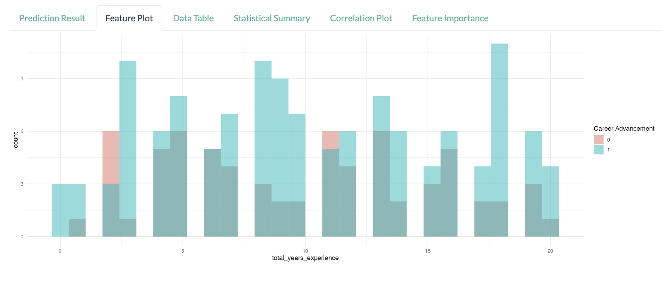
Building Predictive Models using ML
We utilized the Random Forest algorithm to build predictive model for forecasting career advancement probabilities based on certain features such as years of experience and skill counts.

Slide 14
Demo

Slide 15
Future Scope

Slide 16
Future Scope
The future scope for this project could encompass several avenues for enhancement and expansion, including leveraging APIs:
Integration with Professional Networking Platforms : Integrating the application with professional networking platforms like LinkedIn, Indeed, or Glassdoor could provide access to real-time data on job postings, industry trends, and career trajectories. This integration could enable users to receive personalized career advancement recommendations based on their profiles and the current job market.
Interactive Career Planning Tools : Expanding the application to include interactive career planning tools, such as goal setting, competency mapping, and professional development plans, could empower users to take proactive steps towards achieving their career goals. Gamification elements and progress tracking features could further engage users and motivate them to pursue continuous growth and advancement.

Slide 17
Thank you
- Greeshmanth Srireddy
Sai Dhanya Kakarala
Praful Chand Potluri

